Slide 1
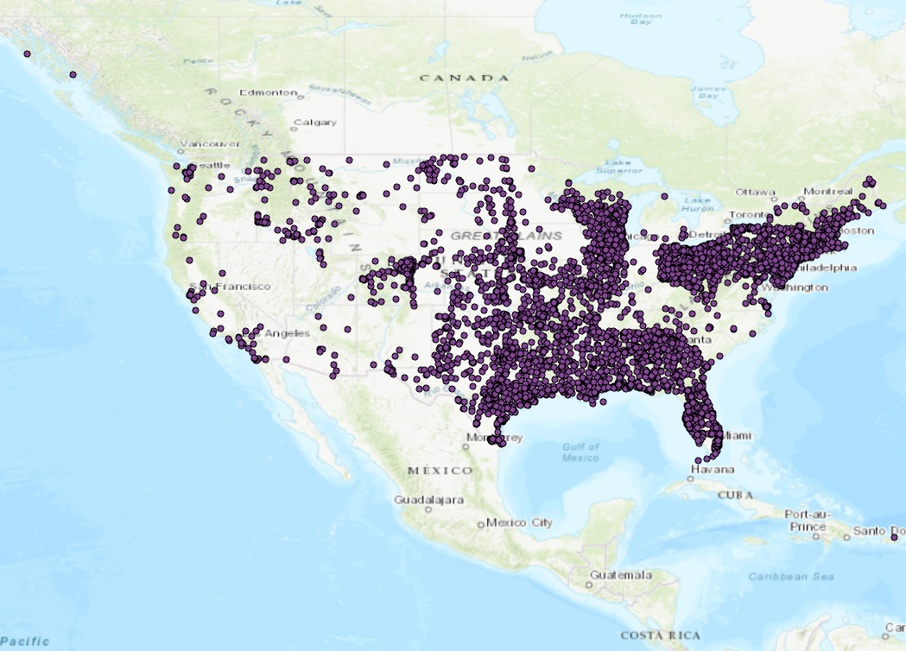

Slide 2
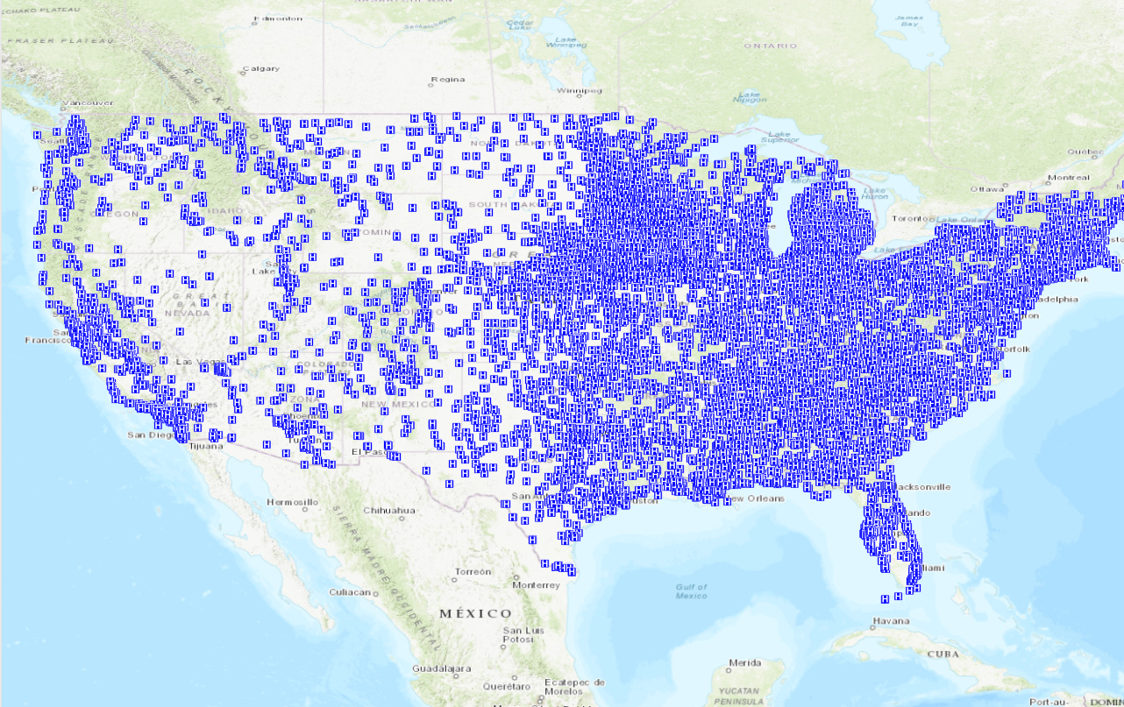

Slide 3
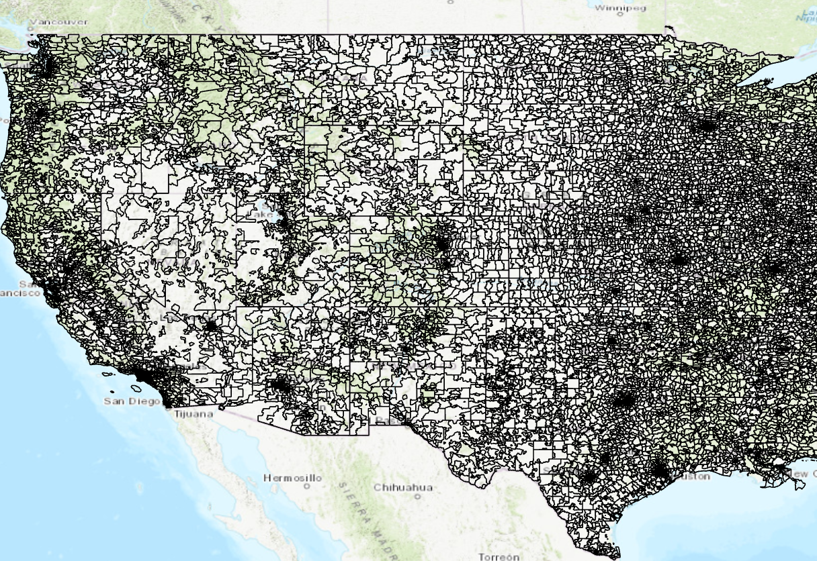

Slide 4
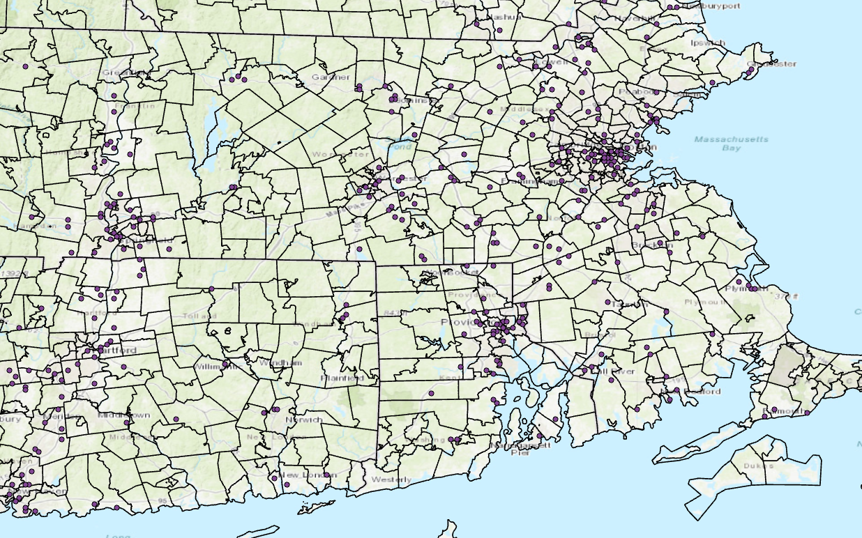

Slide 5
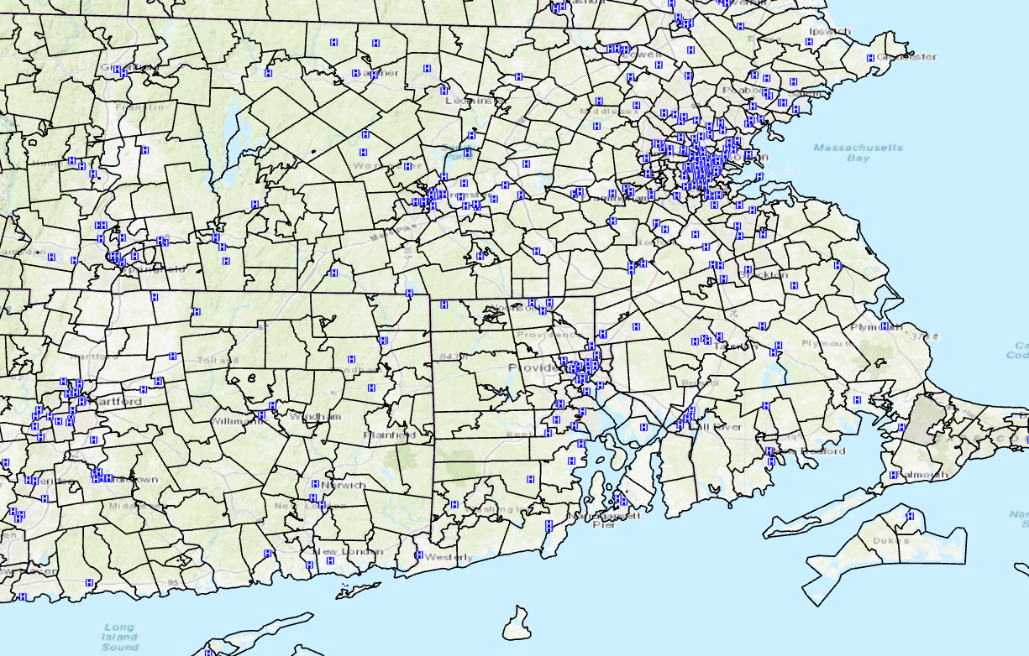

Slide 6
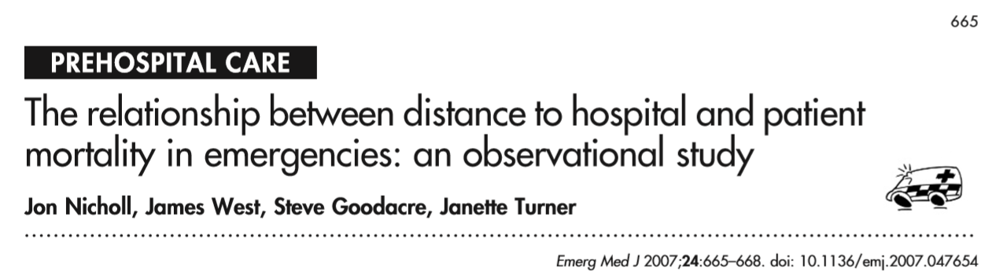
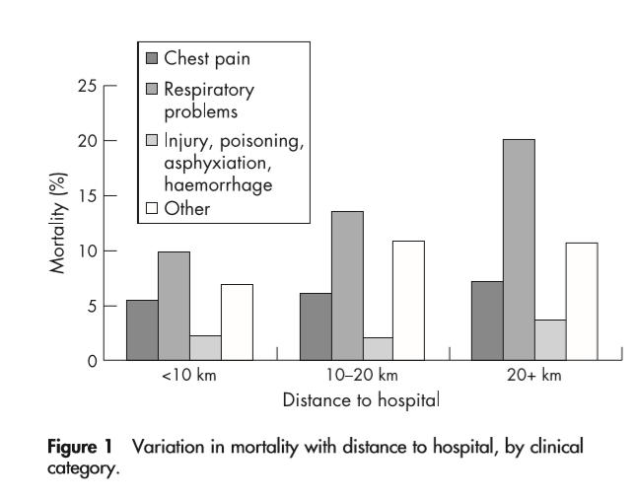

Slide 7
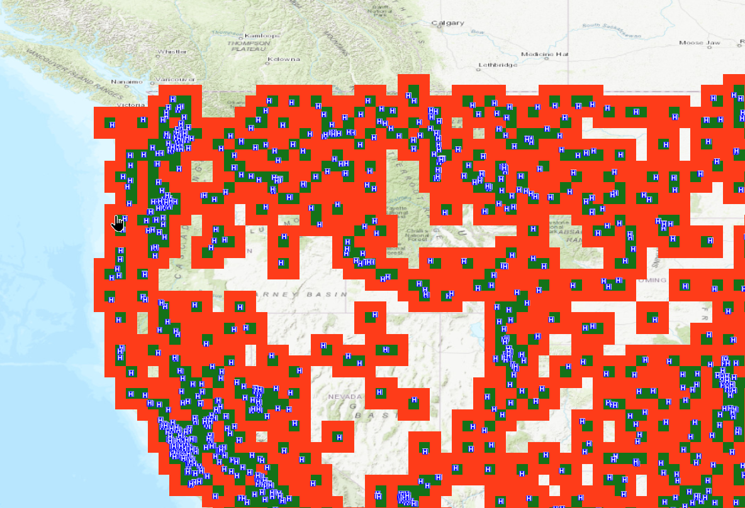

Slide 8
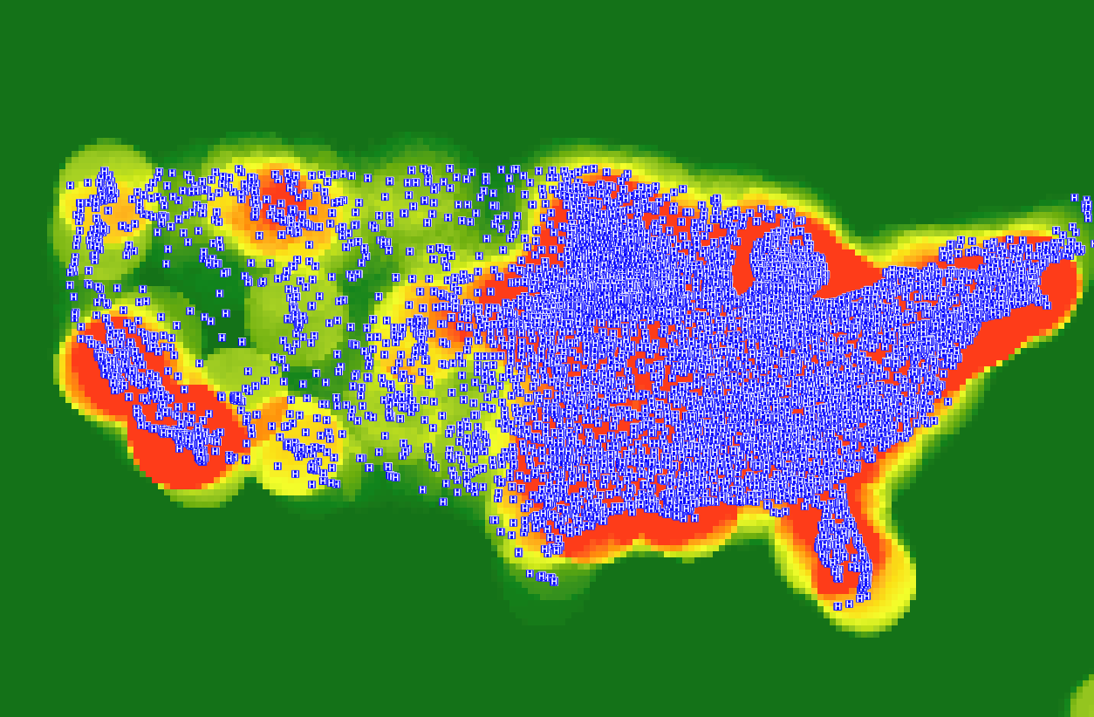

Slide 9
DATA SET
PatientID | Date | Zip code | Injured parts | History | Population | Income | Distance/Density from Hospital | Weather | Temperature
1 | 1/3/2016 | 10000 | Arm | Bite~~ | 2000000 | 240000 | 20 | Rain | 39
2 | 1/3/2016 | 10000 | Leg | ~~ | 2000000 | 240000 | 20 | Rain | 39
3 | 1/3/2016 | 10000 | Hand | ~~ | 2000000 | 240000 | 20 | Rain | 39
4 | 1/3/2016 | 10001 | Leg | ~~ | 1400000 | 640000 | 30 | Sunny | 45
# Patients | Date | Zip code | Injured parts | History | Population | Income | Hospital | Weather | Temperature | Arm | Leg
3 | 1/3/2016 | 10000 | Arm | Bite~~ | 2000000 | 240000 | 20 | Rain | 39 | 1 | 1
1 | 1/3/2016 | 10001 | Leg | ~~ | 1400000 | 640000 | 30 | Sunny | 45 | 0 | 1

Slide 10
NLP

Slide 11
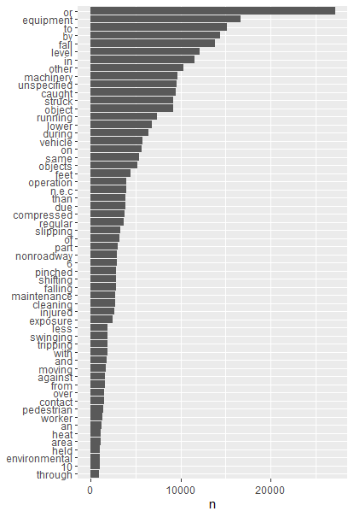

Slide 12
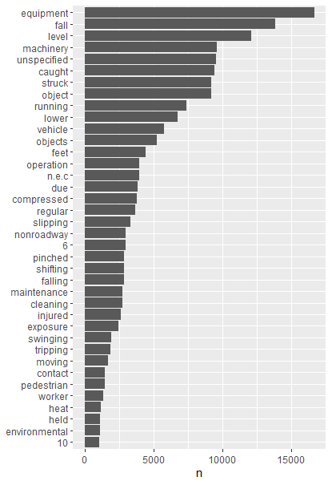
https://www.tidytextmining.com/sentiment.html

